Slide 1
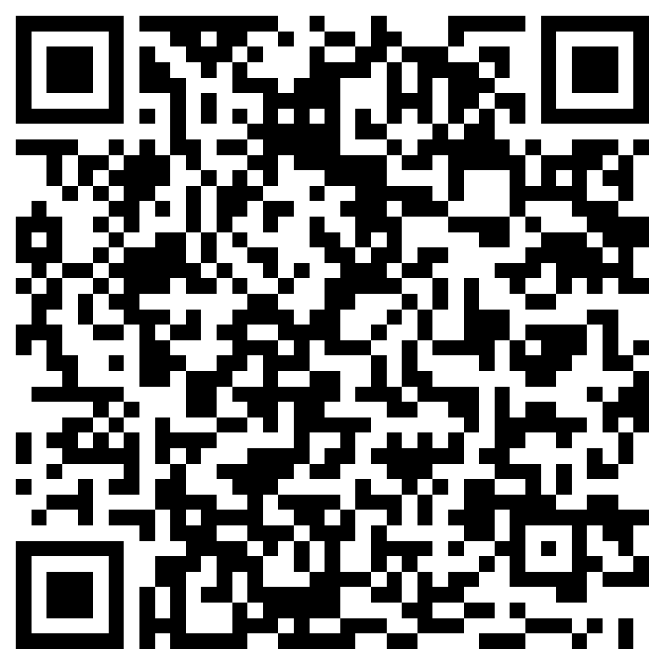
Join The Coding Club
https://forms.office.com/Pages/ResponsePage.aspx?id=VGZw_NSNrUO32IhD8WGXXigPwIXu8JZHuKz_ckepTQJUMzk2NEZCQjFXR1I2MUc0RllOTk1UVjAxTS4u
To get on the email list and get more info, scan the QR code to fill out the form
Meetings will be held on Thursdays at 17:00 in S&E Room 303
All are welcome from the most experienced coders to absolute beginners

